Slide 1

Enhancing Search Engine Relevance for Video Subtitles
By:
RajamaheshwarReddy(IN1240188)
Mukku Sumanth(IN1240418)

Slide 2
Introduction
In the fast-evolving landscape of digital content, effective search engines play a pivotal role in connecting users with relevant information. For Google, providing a seamless and accurate search experience is paramount. This project focuses on improving the search relevance for video subtitles, enhancing the accessibility of video content.
Objective
Develop an advanced search engine algorithm that efficiently retrieves subtitles based on user queries, with a specific emphasis on subtitle content. The primary goal is to leverage natural language processing and machine learning techniques to enhance the relevance and accuracy of search results.

Slide 3
Steps Followed:
Data Preprocessing :
Clean text data (e.g., remove timestamps) crucial for vectorization.
Vectorization :
Vectorize subtitle documents and user queries.
Cosine Similarity :
Calculate cosine similarity between document and query vectors.
Result Retrieval :
Return most similar documents based on similarity scores.

Slide 4
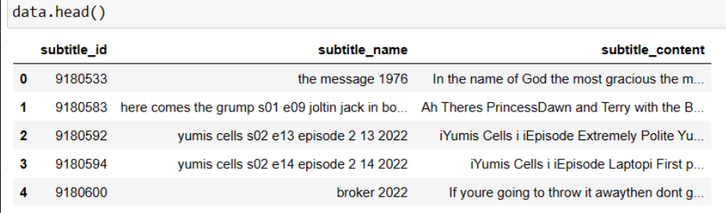
Data Processing : Read data from database tables using Python.Handle ZIP files with Latin-1 encoding.
Data Operations: Clean data: remove timestamps, leadingcharacters, symbols, numbers,and tags.
Select 30% of the data.
Result:
Show cleaned and processed data.

Slide 5
Text Vector Generation
BERT-based SentenceTransformers for semantic search.
Document Chunker :
Handling large documents.
Mitigating information loss with overlapping windows.
Embedding Storage in ChromaDB :
Efficient storage and retrieval.

Slide 6
Retrieving Documents
Take the user's search query.
Preprocess the query (if required).
Create query embedding.
Using cosine distance, calculate the similarity score between embeddings of documents and user search query embedding.
These cosine similarity scores will help in returning the most relevant candidate documents as per user’s search query.

Slide 7
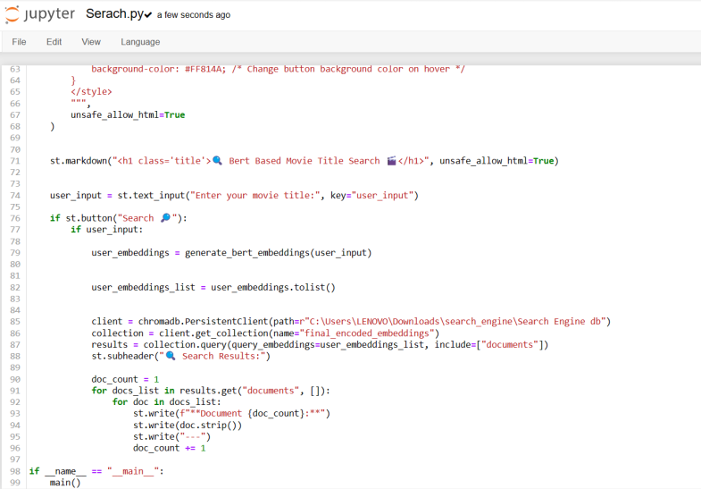
The code is for a streamlit app that acts as a movie subtitle search engine.
It reads data from a CSV file into a Pandas DataFrame, handles user search queries, and displays results using HTML templates with CSS styling.

Slide 8
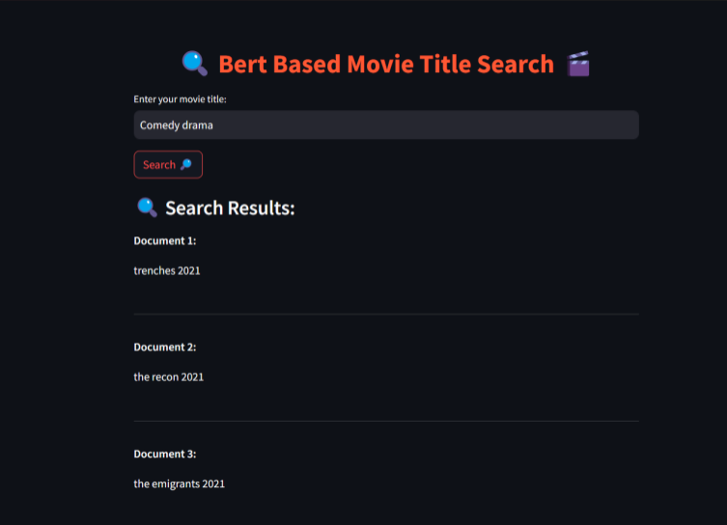
Output Result:The code creates a web app where users can search for movie subtitles. The results are displayed on a page styled with specific colors and layout

Slide 9
Conclusion
This project aims to enhance search engine relevance for video subtitles,employing advanced techniques like semantic understanding and efficient document processing.
Its Improved search relevance for video subtitles. it has Potential enhancements or extensions.

Slide 10

THANK YOU

